Slide 1
Evtol release runs
Jim Wang
12/11/2023

Slide 2
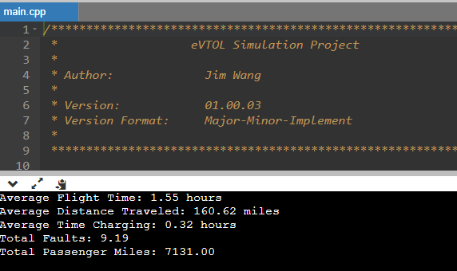
V01-00-03 release run
With 3 chargers and 20 vehicles

Slide 3
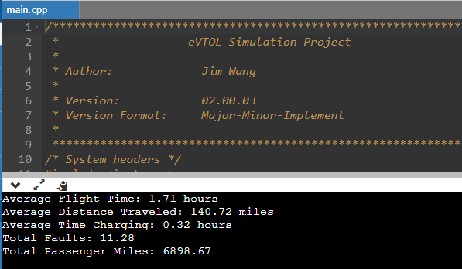
V02-00-03 release run
With 3 chargers and 20 vehicles

